Slide 1
Price Optimization
Revenue Maximization
Profit Maximization

Slide 2
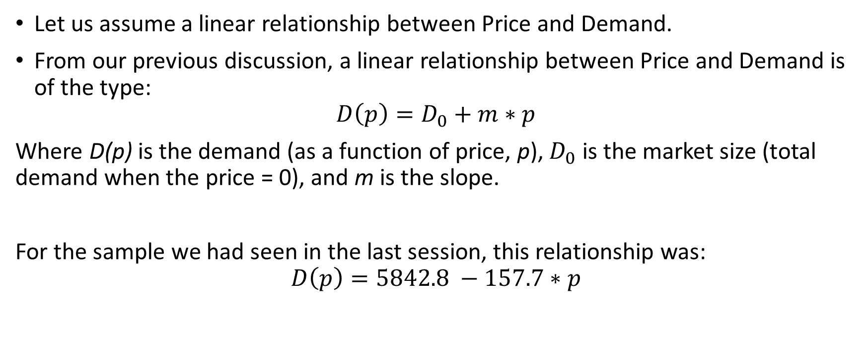
Demand response curve
Let us assume a linear relationship between Price and Demand.
From our previous discussion, a linear relationship between Price and Demand is of the type:
$$D\left(p\right)=D_{0}+m∗p$$
Where D(p) is the demand (as a function of price, p), $D_{0}$ is the market size (total demand when the price = 0), and m is the slope.
For the sample we had seen in the last session, this relationship was:
$$D\left(p\right)=5842.8 −157.7∗p$$

Slide 3

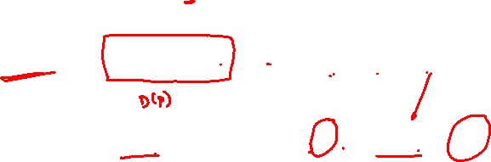
Sales Revenue function
Revenue from sales is always calculated as
$$Revenue=Demand∗Price$$
$$R\left(p\right)=D\left(p\right)∗p$$
$$R\left(p\right)=\left(D_{0}+m∗p\right)∗p=D_{0}∗p+m∗p^{2}$$
For our numerical example, $R\left(p\right)=5842.8∗p−157.7∗p^{2}$

Slide 4
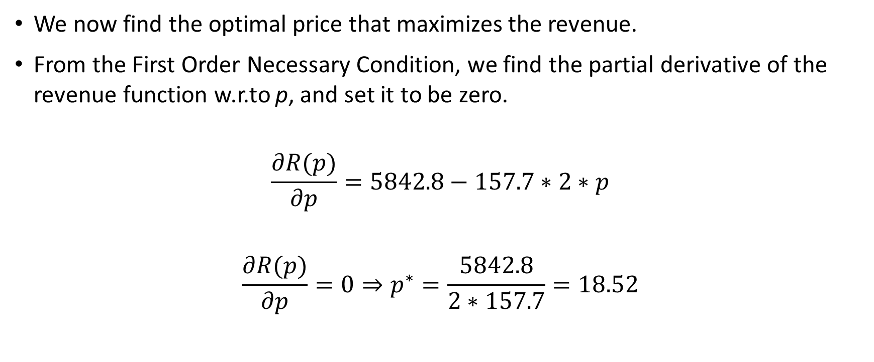
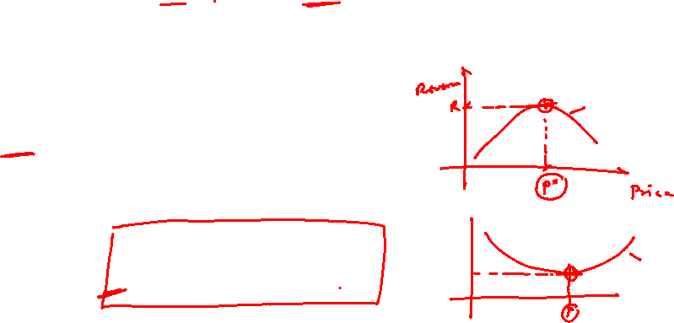
Revenue maximization
We now find the optimal price that maximizes the revenue.
From the First Order Necessary Condition, we find the partial derivative of the revenue function w.r.to p, and set it to be zero.
$$\frac{∂R(p)}{∂p}=5842.8−157.7∗2∗p$$
$$\frac{∂R(p)}{∂p}=0⇒p^{∗}=\frac{5842.8}{2∗157.7}=18.52$$

Slide 5
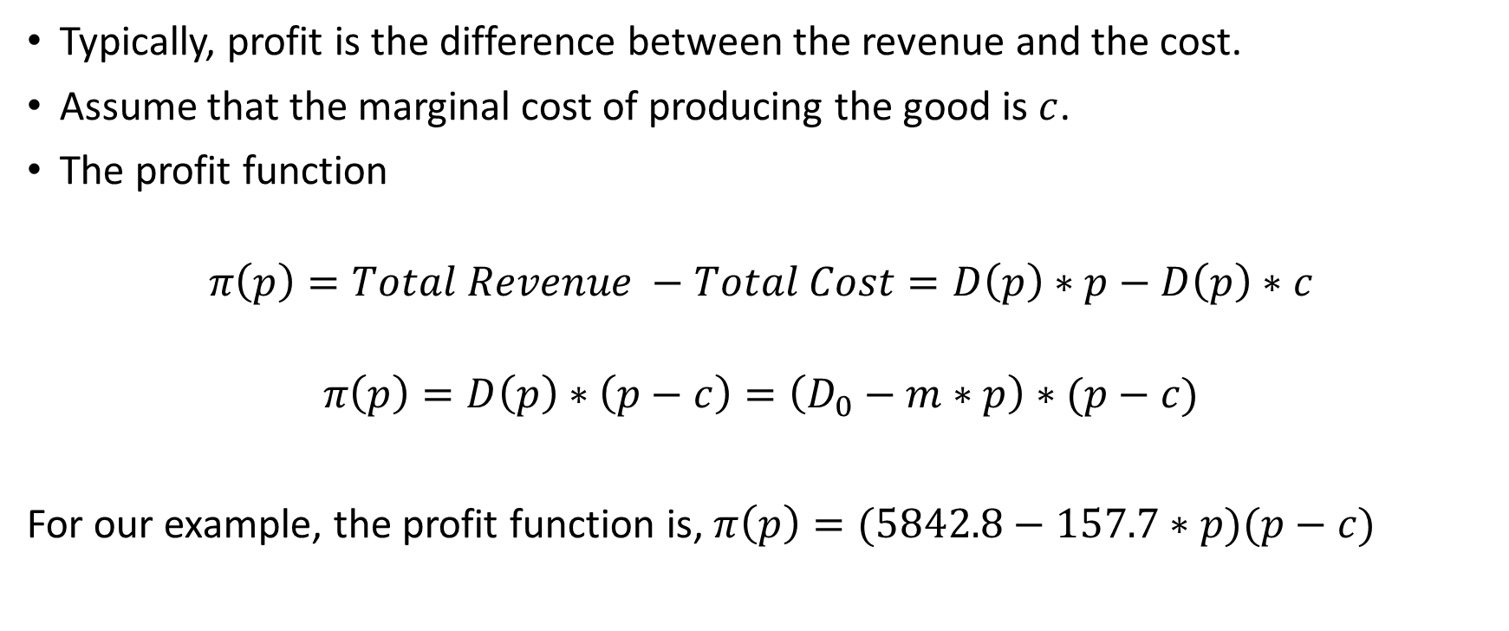
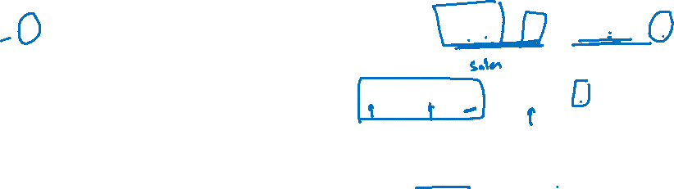
Profit function
Typically, profit is the difference between the revenue and the cost.
Assume that the marginal cost of producing the good is $c$.
The profit function
$$π\left(p\right)=Total Revenue −Total Cost=D\left(p\right)∗p−D\left(p\right)∗c$$
$$π\left(p\right)=D\left(p\right)∗\left(p−c\right)=\left(D_{0}−m∗p\right)∗(p−c)$$
For our example, the profit function is, $π\left(p\right)=(5842.8−157.7∗p)(p−c)$

Slide 6

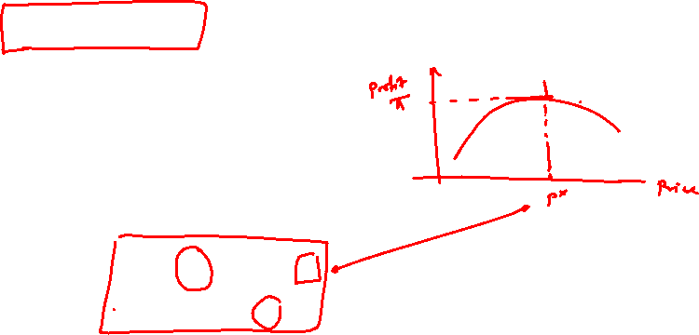

Profit maximization
To find the optimal price that maximizes profit, we again use the First Order Necessary Condition,
$$\frac{∂π(p)}{∂p}=D_{0}−2∗m∗p−m∗c$$
$$\frac{∂π(p)}{∂p}=0⇒p^{∗}=\frac{D_{0}+m∗c}{2∗m}$$

Slide 7

Profit maximization
For our numerical example, let the marginal cost be 15.
So the profit maximizing price is,
$$p^{∗}=\frac{5842.8+157.7∗15}{2∗157.7}=26.02$$

